Slide 1

TEAM NAME: APSC
TEAM MEMBERS
Gracy Gulati-2210990331
Gunn Arora-2210990333
Parth Batra- 2210990642
Guransh Singh-2210990335

Slide 2
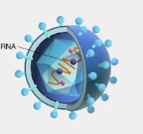

PROJECT - DISEASE PREDICTION
In Our project we have predicted various Diseases Such as:
Autism-Prediction
Parkinson's-Prediction
Covid-19-Prediction
Stroke-Prediction

Slide 3
Techniques Used
Artificial Intelligence: Artificial Intelligence(AI) refers to a Computer System capable of performing complex tasks that historically only a human could do, such as reasoning, making decisions or solving problems.
Machine Learning: Machine Learning(ML) is defined as a disciple of Artificial Intelligence(AI) that provides machines the ability to automatically learn from data and past experiences to identify patterns and make predictions with minimal human intervention.

Slide 4
AUTISM
Autism Stands for Autism Spectrum Disorder(ASD).
It is a neurological and developmental disorder that affects how people interacts with others, communicate, learn and behave.
It is described as “developmental disorder "because symptoms generally appears in first 2 years of life.
Various Symptoms of Autism are:
Decreased sharing of interests with others.
Difficulty appreciating their own and other’s emotion
Aversion to maintain eye contacts.
Stilted or Scripted Speech

Slide 5

Predicting Autism in Toddlers
The objective of the project is to develop a model that can accurately determine whether a toddler has autism or not based on various factors such as screening Questions, result, age, gender and much more.
Attribute | Description
Case_No | Unique ID for each toddler
A1 | Result of autistic screening question 1
A2 | Result of autistic screening question 2
A3 to A10 | Results of other screening questions
Age Mons | Age of the toddler in months
Qchat_10 Score | Total score of the screening questions
Sex | Gender of the toddler
Ethnicity | Place the toddler belongs to
Jaundice | Whether the toddler had jaundice or not
Family_mem_with_ASD | Whether any family member has ASD or not
Who completed the test | Person who completed the screening test
Class/ASD Traits | Whether the toddler has autism or not (1 for Yes, 0 for No)

Slide 6
So we have categorized our disease detection project in 5 different ways
Read and Preprocessing Data: In this we will have a look on our dataset and understand each columns one by one.
Exploratory Data Analysis(EDA):In this we will try to compare two or more columns from our given data set and also draw a graph for it to get better understanding or relations between any two or more than two columns.
Feature Extraction: Feature extraction is a process in machine learning and data analysis that involves identifying and extracting relevant features from the raw data and these features are later used to create more informative dataset which is further utilized in predictions.
Data cleaning: In this we clean the useless data from our data set and make it easy to understand further.
Predictions: This is the last and the most important step in this we use various machine learning models to predict data after we trained them on our dataset.

Slide 7
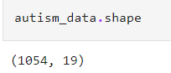
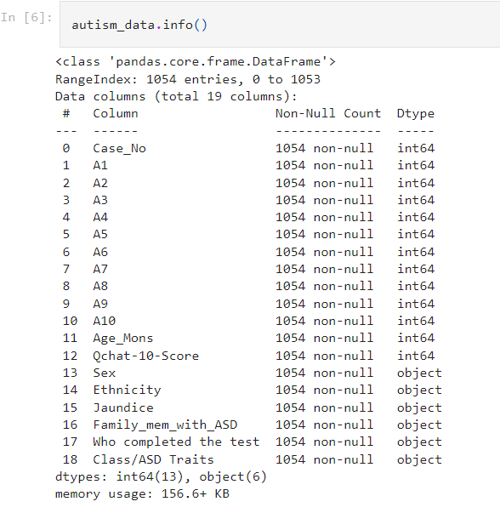
Read and Preprocessing Data
Shape basically gives us the dimension of our dataset such as row*columns
In this data set we have 1054 rows and 19 columns
Let’s have a brief look on all our columns of dataset and their types

Slide 8
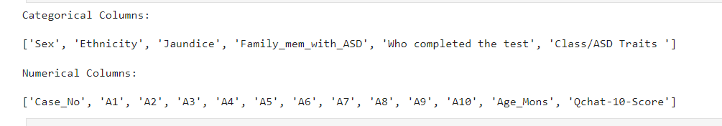
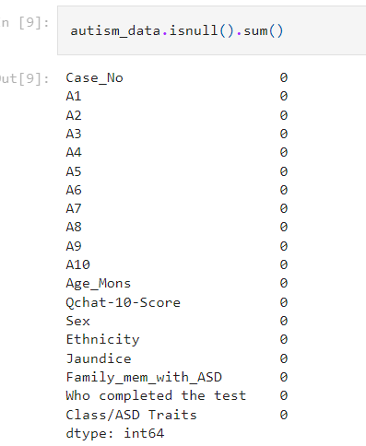
Let’s see that different types of columns we have in our dataset
Let’s check if there is any null value in our dataset or not
No null values are find in our dataset which is good

Slide 9
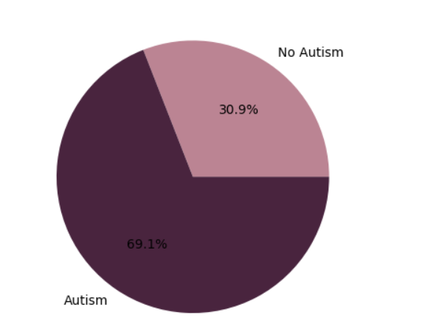
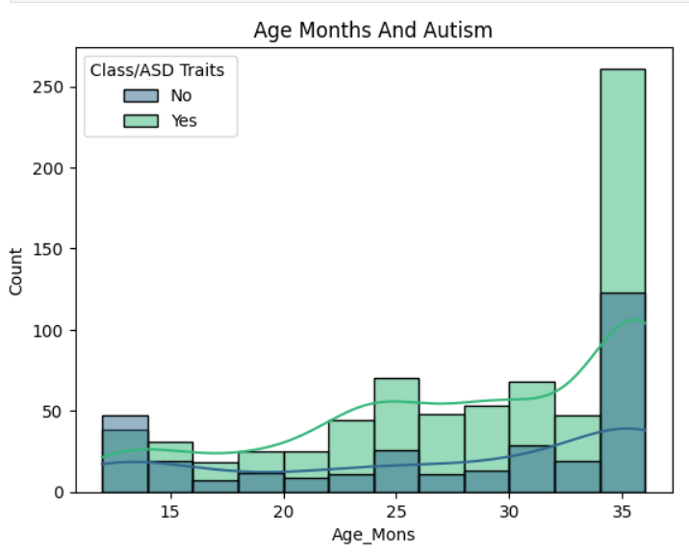
Exploratory Data Analysis
Percentage of Toddlers having Autism or not
Toddlers having autism based on Age in months

Slide 10
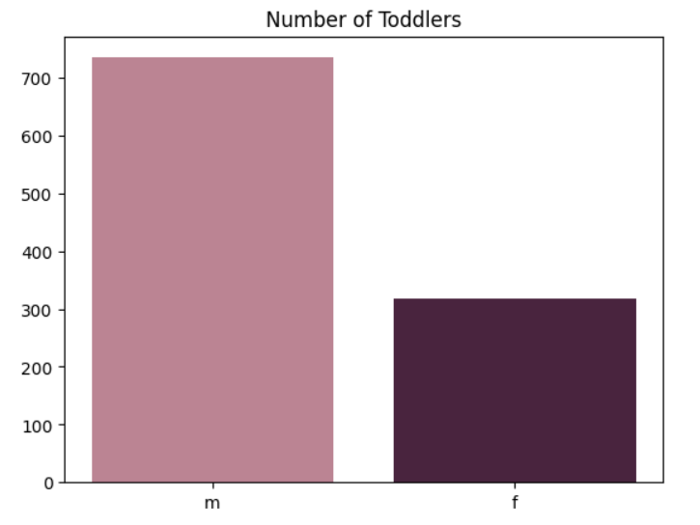
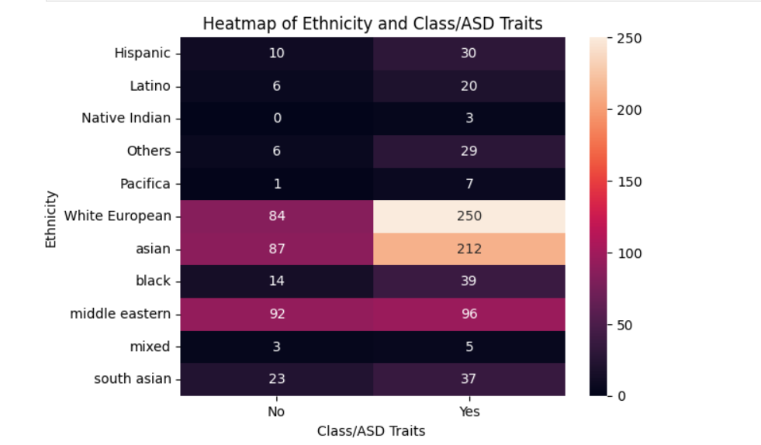
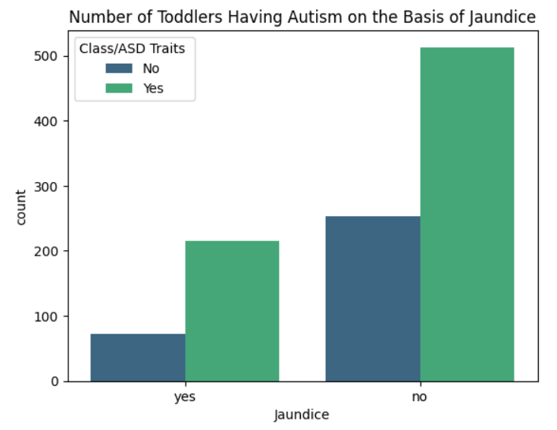
Number of Toddlers belonging to different Ethnicity
Number of males and female affected by Autism

Slide 11
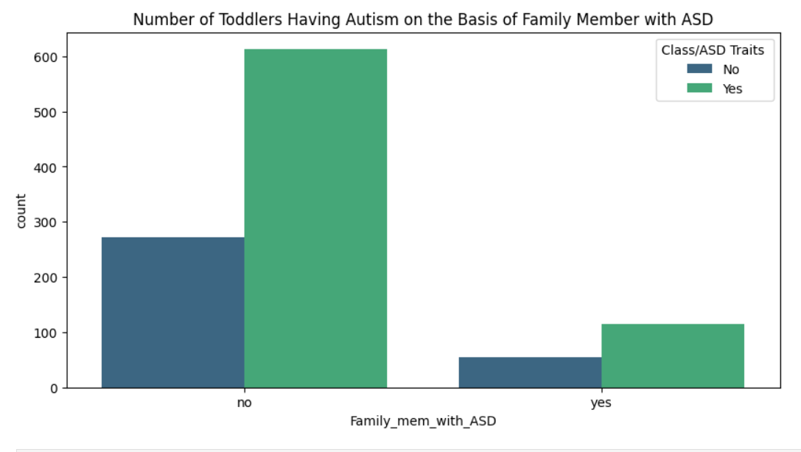
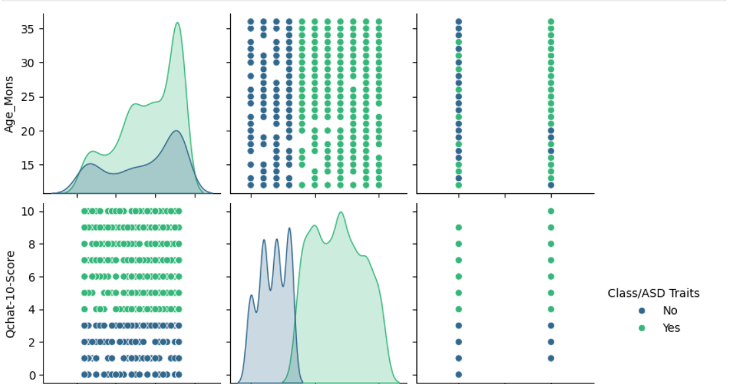

Slide 12
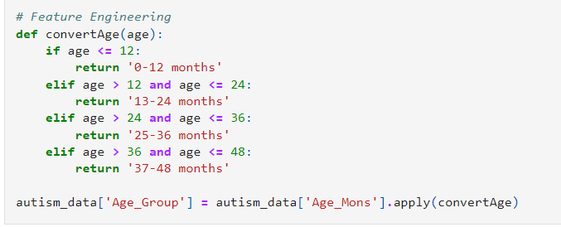
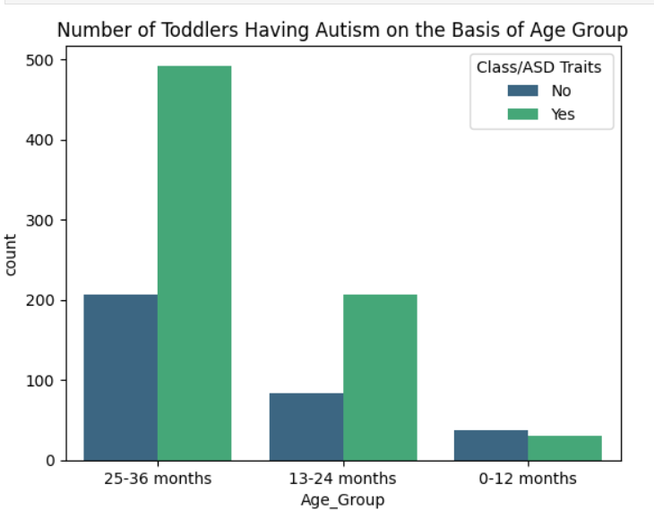
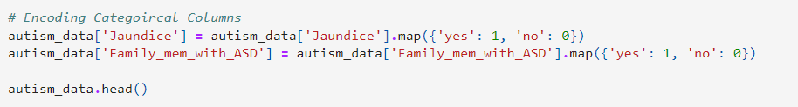
Feature Extraction
Change the description of age according to our self this is called feature engineering
Conversion of Categorical data into numerical for our easy usage

Slide 13
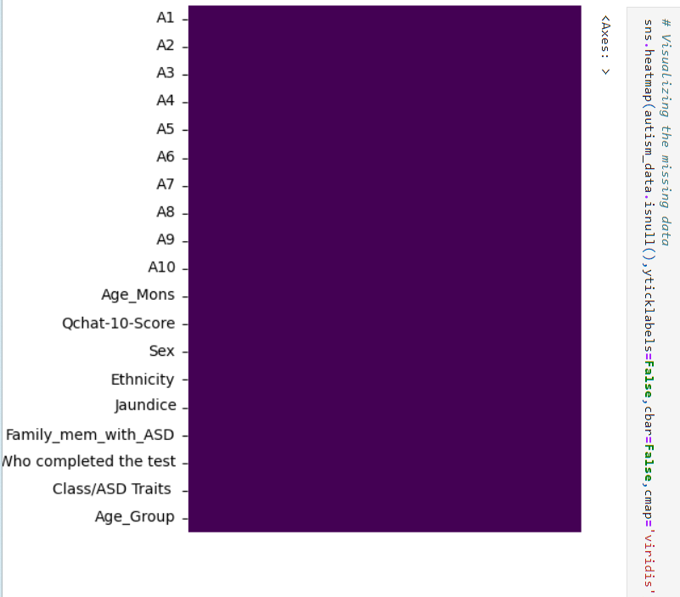
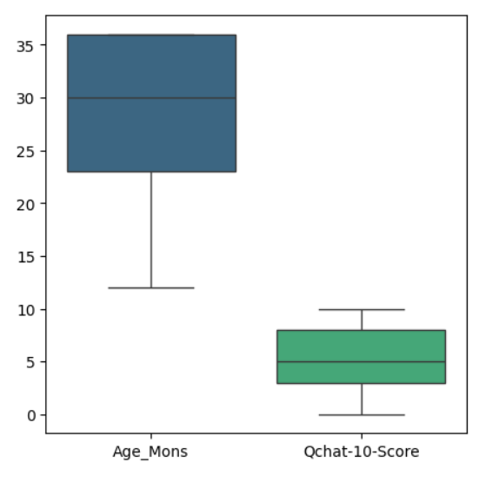
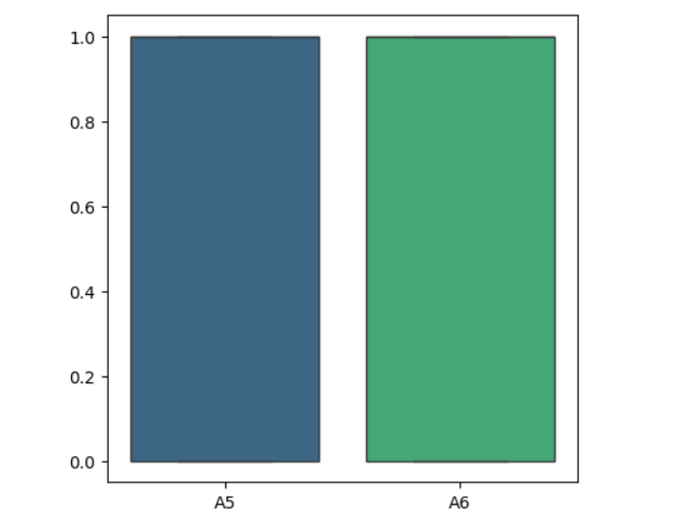
Data Cleaning
After thoroughly examining our dataset. We have seen it is clean from our outliers as well as null values
So we can confidently say that our data set is in good shape

Slide 14
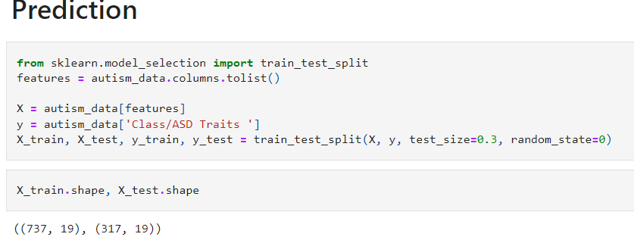
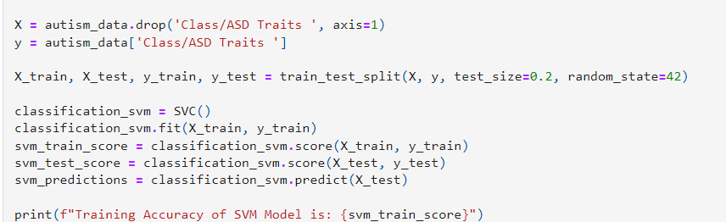
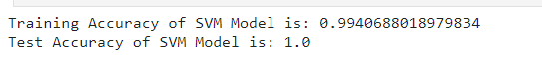
Prediction
Divided our dataset into two parts test and train using scikit-learn and check the shape of training and testing Dataset.
*Trained our dataset using SVM and check it’s Accuracy

Slide 15
Parkinson’s
Parkinson disease is a brain disorder that causes unintended or uncontrollable movements such as shaking, stiffness, and difficulty with balance and coordination
Symptoms usually begins gradually and worsens over time. As the disease Progresses people may have difficulty in talking and walking. They may also have mental and behavioral changes.
Symptoms of Parkinson’s Disease:
Tremor in hands, arms ,legs.
Slowness of movement.
Impaired balance and coordination, sometimes leading to falls.

Slide 16
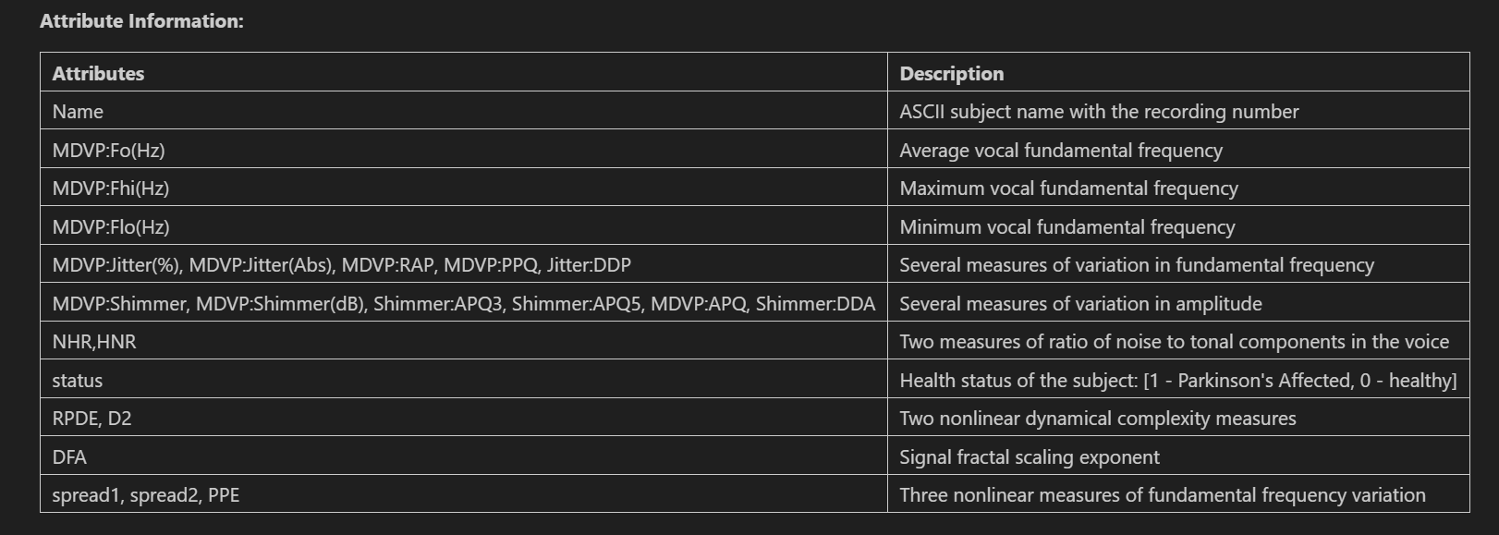
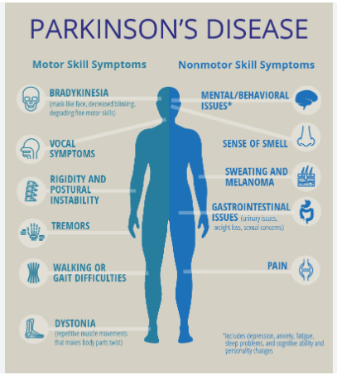
The aim of our model is to detect early symptoms of Parkinson’s disease . So that it can be cured easily in future.

Slide 17
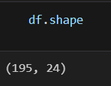
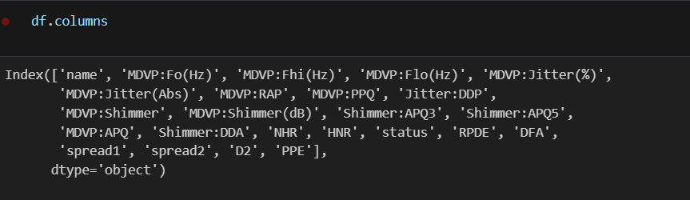
Read and Processing Data
No of rows and columns in our data set. In this we have 195 rows and 24 columns
Name of all Columns of our Data Set
Dividing our all columns into two categories:
1.Categorical Variables.
2.Numerical Variables.

Slide 18
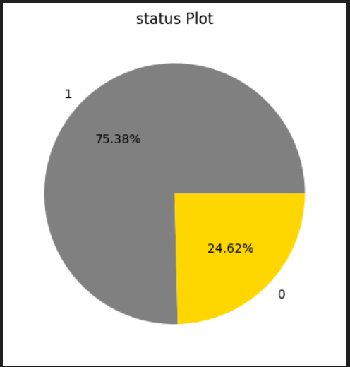
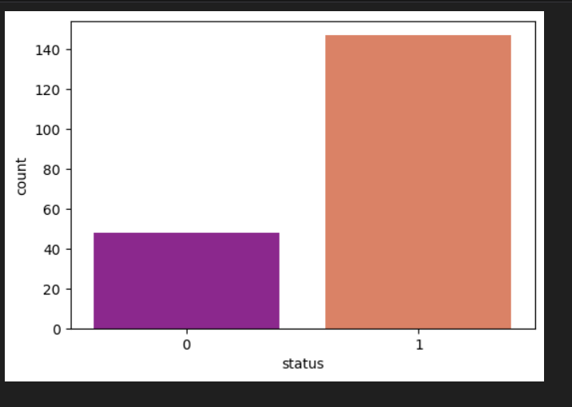
Exploratory Data Analysis
1 means people having Parkinson’s and 0 means no Parkinson's
No of people having Parkinson is represented by 1 and not having Parkinson is represented by 0

Slide 19
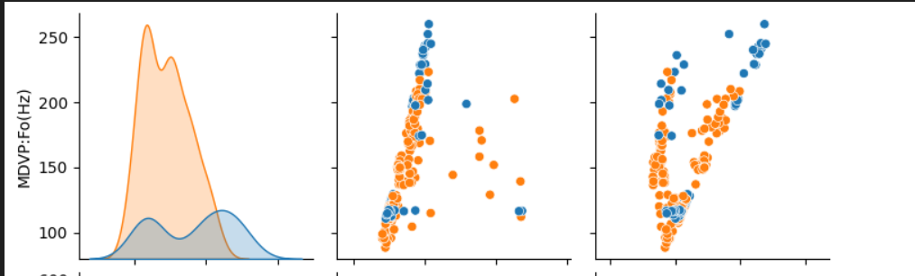
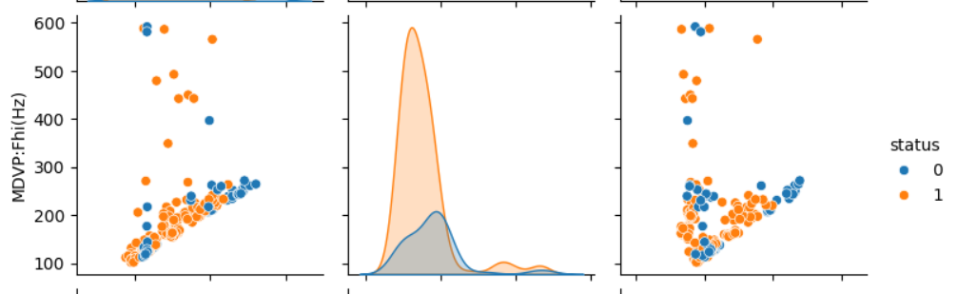
AVG LOCAL FUNDAMENTAL FREQUENCY (MDVP:Fo(Hz))
MAXIMUM VOCAL FUNDAMENTAL FREQUENCY (MADVP:Fhi(Hz))

Slide 20
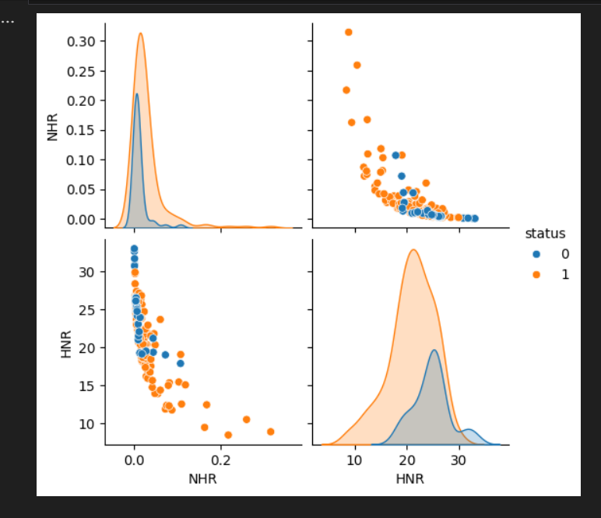
Two measures of ratio of noise to tonal components in the voice
There are two measures of ratio of noise to tonal components in the voice - NHR,HNR

Slide 21
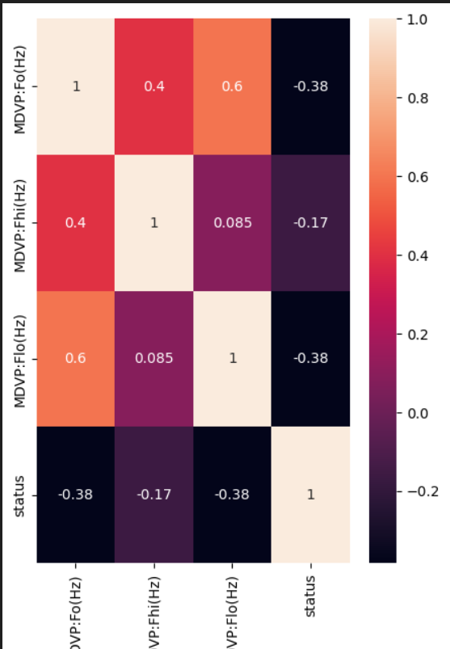
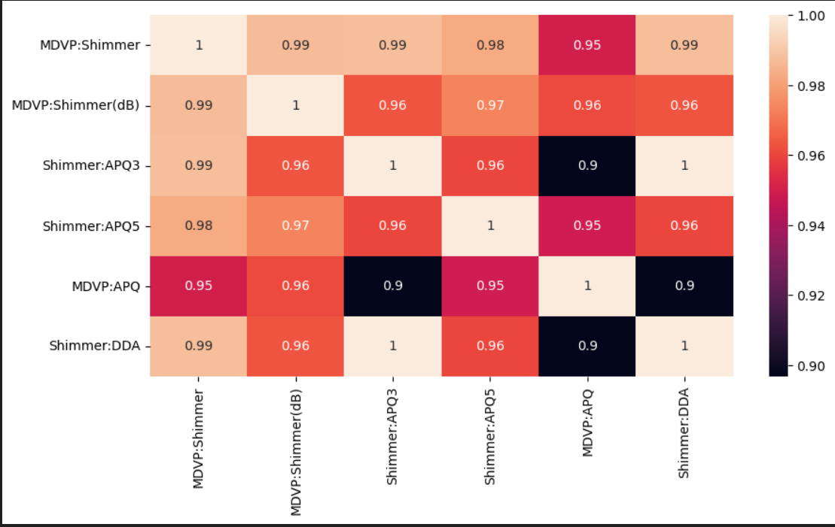
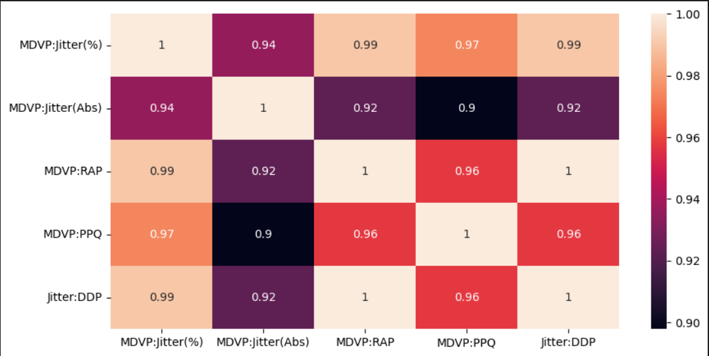
Heatmaps for frequency variation, amplitude variation and fundamental frequency variation

Slide 22
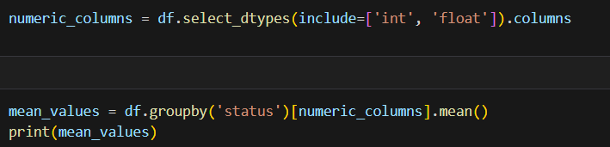
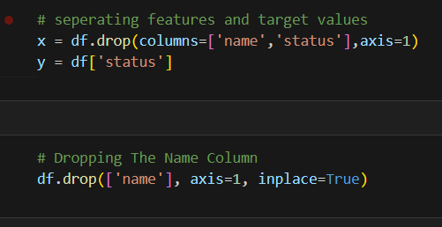
Feature Extraction
Finding the missing values and filling by the mean in between them.

Slide 23
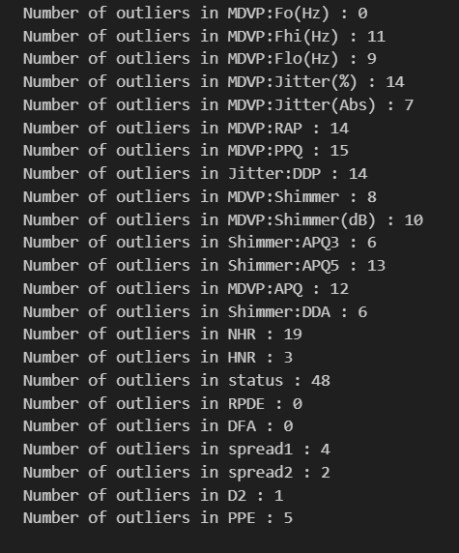
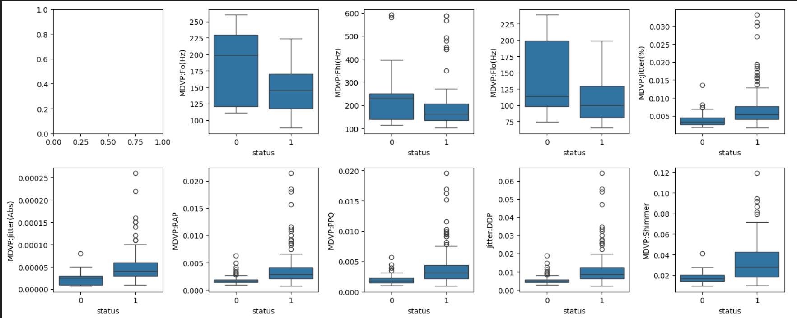
Data Cleaning
Detecting the Outliers and removing it using IQR Approach

Slide 24
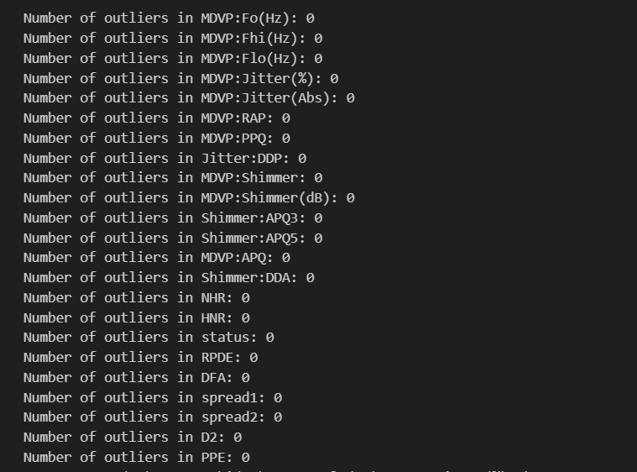
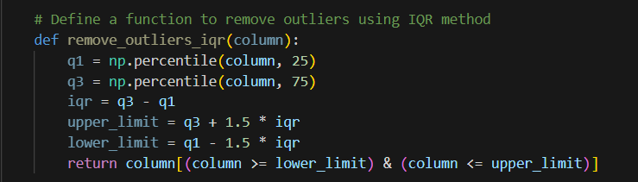
IQR Method for removing Outliers.
Outliers Removed Successfully

Slide 25
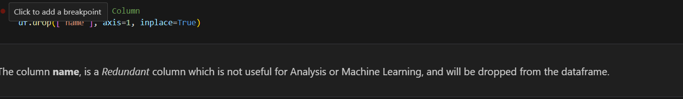
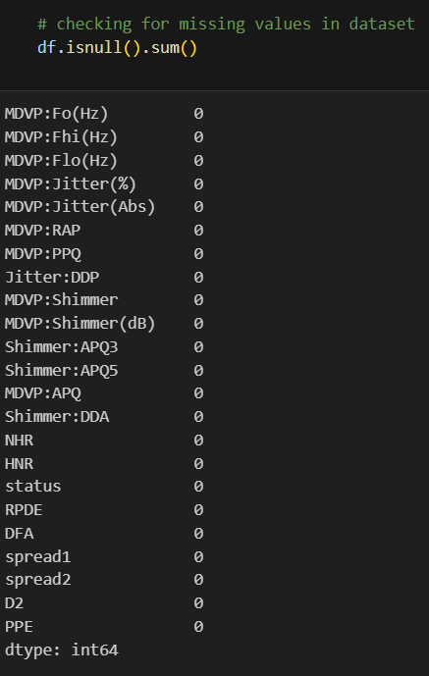
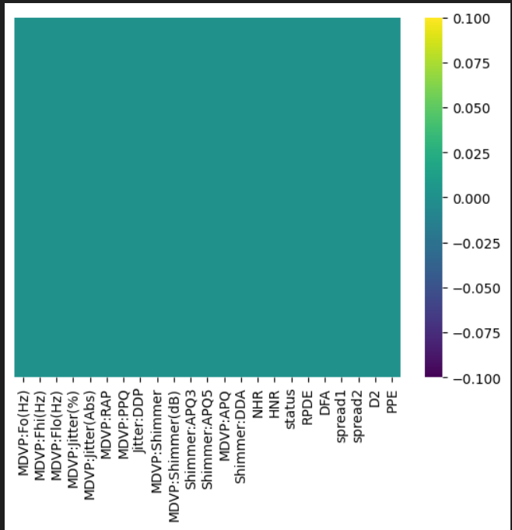
Now, since there are NO MISSING VALUES, NO DUPLICATE VALUES AND NO OUTLIERS PRESENT IN THE DATASET, we can conclude the data cleaning process of our dataset.
So now our **DATASET IS CLEAN**.

Slide 26
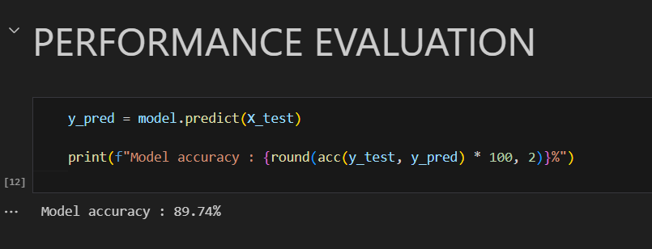
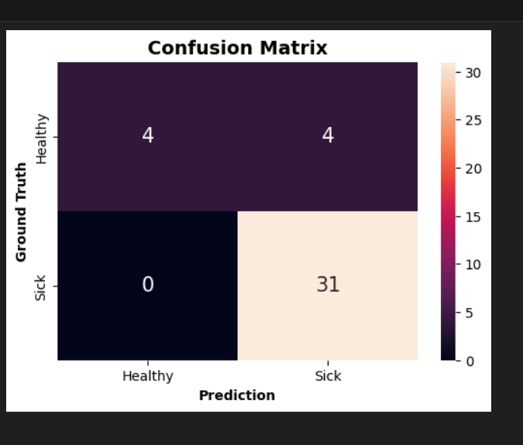
Prediction

Slide 27
Covid-19
Covid 19 is a infectious disease caused by the most recently discovered coronavirus. This new virus and
Disease were unknown before the outbreak began in Wuhan, China, in December 2019. This disease causes
Respiratory illness(like the flu) with symptoms such as a cough, fever , and in more severe cases, difficulty breathing
Symptoms of Covid 19:
Dry Cough
Shortness of breath
Loss of taste or smell
Extreme tiredness, called fatigue.
Fever or chills.

Slide 28
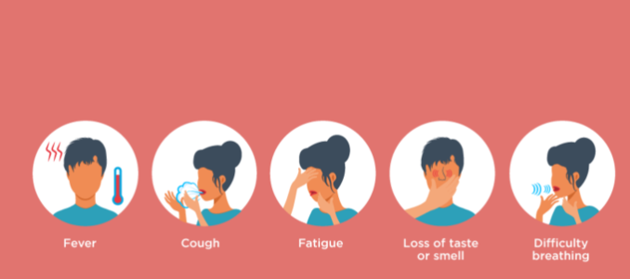
The aim of our model to predict the outbreak of covid 19 using Machine learning.
Column | Description
Confirmed | Number of persons confirmed to have Corona Virus
Deaths | Number of persons who died due to Corona Virus
Recovered | Number of persons who recovered from Corona Virus
Province/State | Province or State of the country where Corona Virus is spreading
Country | Country where Corona Virus is spreading
Latitude | Latitude of the country
Longitude | Longitude of the country
Date | Date of the record update
Active | Number of active cases
WHO Region | A WHO region is one of the six geographical areas into which the World Health Organization (WHO) divides the world for better coordination of public health efforts.

Slide 29
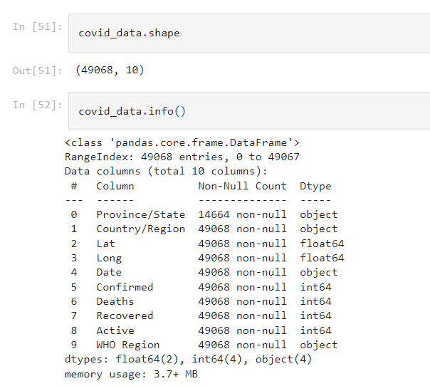
Reading and Processing Data
This describes that our dataset has 49068 rows and 10 columns
This gives us the list of columns and their datatypes
*Let’s rename column for our easy understanding of dataset.

Slide 30
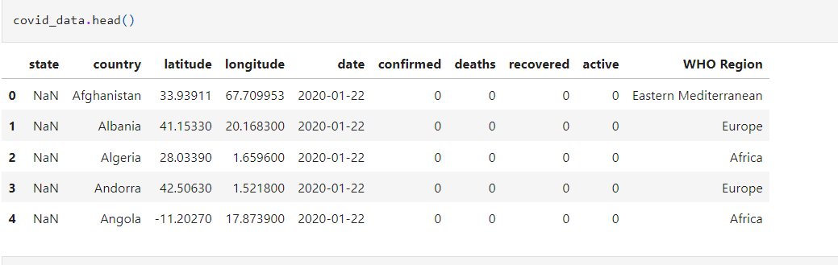
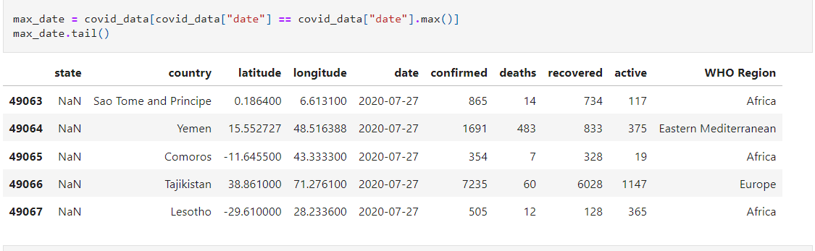
Returns first five rows of our dataset
Return last five rows from our dataset

Slide 31
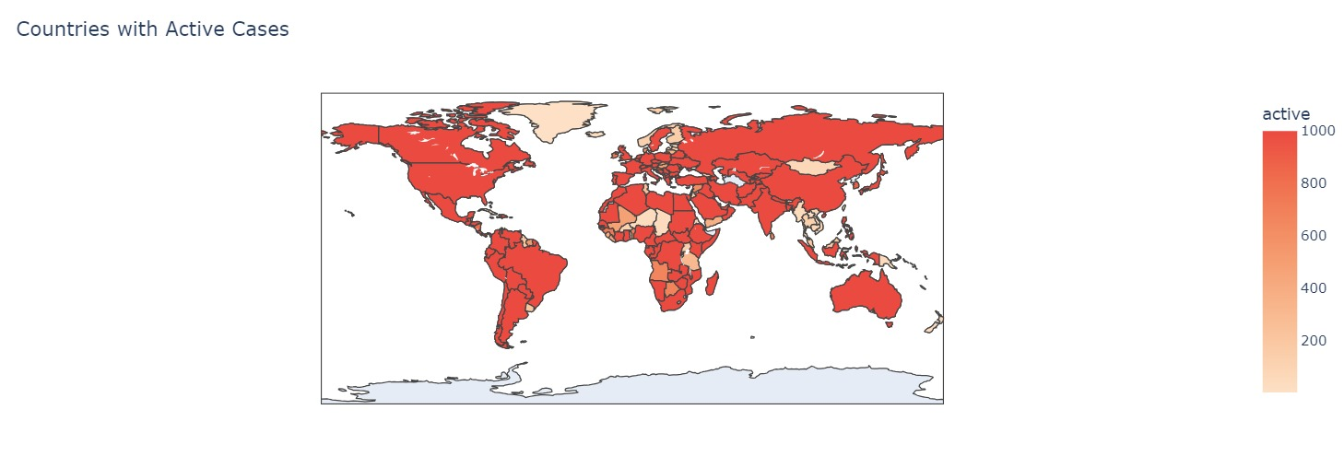
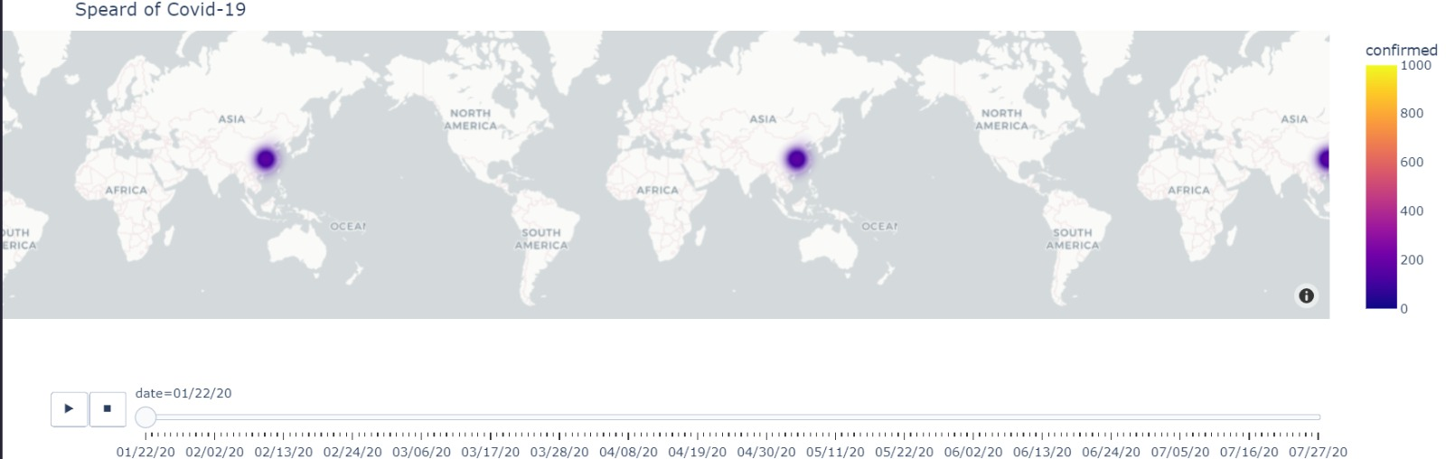
Exploratory Data Analysis

Slide 32



Slide 33




Slide 34


Feature Extraction
Checking null values if any and got that state has too much null values let’s
Correct it.
Graphical Representation of state having null values in it

Slide 35


Code for correcting null values we got in state
Graphical representation of State after removing null values again

Slide 36



Detection Outliers if any and remove it
We see that outliers are detected let’s remove it using IQR Method
After applying Iqr range for outliers removal
Dropping column we don’t need in our dataset
Confirming whether columns are deleted or not
**After removing all Outliers and columns we don’t need further. Now our dataset is Clean and we are good to move further**.

Slide 37


Prediction
1.Prediction using SVC(Support Vector Machines)

Slide 38


2.Logistic Regression(LR)

Slide 39


3.Decision Tree Classifier

Slide 40
Stroke
According to the world Health organization(WHO),stroke is the second leading cause of death worldwide, Accounting for approximately 11% of all deaths. This dataset is used to predict the likelihood of a patient Experiencing a stroke based on input parameters such as gender,age,various medical conditions, and Smoking status. Each row in the dataset represents information about an individual patient’s condition
Symptoms of Stroke are:
Sudden confusion, trouble speaking or trouble understanding speech.
Sudden severe headache with no known cause.
Sudden trouble seeing from one or both eyes.
Sudden trouble walking, dizziness or loss of balance or coordination.

Slide 41

Role of our model is to predict stroke using some given data input .
Unknow means not available for that person.
Column Name | Description
id | Unique identification
gender | "Male", "Female", or "Other"
age | Patient's age
hypertension | 0 if the patient does not have a history of hypertension, 1 if the patient has hypertension
heart_disease | 0 if the patient does not have heart disease, 1 if the patient has heart disease
ever_married | "No" or "Yes"
work_type | "children", "Govt_job", "Never_worked", "Private", or "Self-employed"
Residence_type | "Rural" or "Urban"
avg_glucose_level | Average glucose level in blood
bmi | Body mass index
smoking_status | "formerly smoked", "never smoked", "smokes", or "Unknown"
stroke | 1 if the patient had a stroke, 0 if not

Slide 42


Reading and Preprocessing Data
Gives information about each column of dataset along
With their data types.
It gives information about each column in the form of
Percentage min, max and also mean median of data.

Slide 43


Exploratory Data Analysis
1 means stroke yes,0 means stroke is no

Slide 44


1.Heart Disease vs Stroke.

Slide 45



Hypertension Vs Stroke

Slide 46




Slide 47



Feature Extraction and Data Cleaning
Dropping column id as it of no use for further and also checking whether columns is deleted or not

Slide 48


Outlier detection and removal

Slide 49


Use iqr to remove outlier:

Slide 50




Prediction
2.Logistic Regression:
1.Random Forest:
3.SVM:
4.Decision Tree Classifier:

Slide 51
THANK YOU

